Slide 1



A Near-Bed Study on the Affects of Spur Dikes on River Systems
Ramsey Coronado
PI: Guohong Duan, Department of Civil Engineering
Mentor: Mary Yaeger
University of Arizona
Arizona Space Grant Consortium
Statewide Symposium

Slide 2
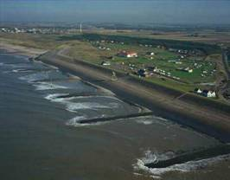
Background: Spur Dikes
Spur Dikes are environmental structures put in place to prevent bank erosion and redirect water flow
Historically, they have been used to “train” a water system
Currently used on the Mississippi and along other water systems
Picture provided by Geograph.com

Slide 3

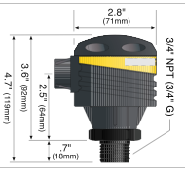
Methodology
Techniques for evaluating the impacts of spur dikes on a fluvial system:
Flume:
  Structure that emulates an open channel water flow
Grid System:
  Systematic approach for evaluating points along a grid
Level Sensor:
  Sends a signal to the surface of water and registers the height of water flow relative to base
Flow Meter
  Uses a triangulation sensor to determine flow in the x-direction, y-direction, and z-direction
Picture provided by Omega.com

Slide 4
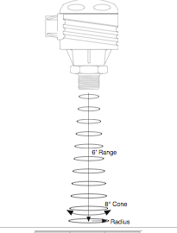
Experimentation
Calibration of Devices
  The initial part of experimentation involves calibration of the sensor to the flume. Electrical signal related to physical parameters.
Collecting Data
  Base study conducted to examine conditions affected by the dikes on the river system at different water flows.

Slide 5
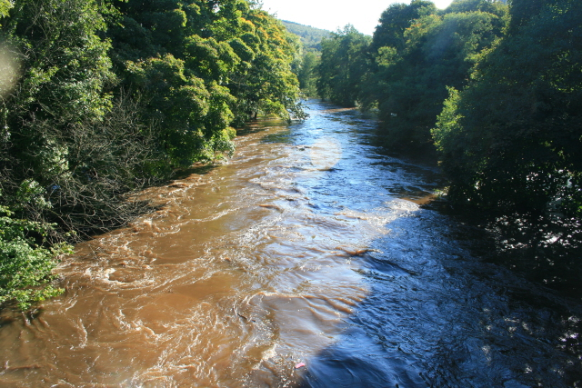
Results
Increased flow along area where spur dikes where present
Increased water level
One of the hydraulic effects was turbulence
Picture provided by Geograph.com

Slide 6
Future of Research
Sediment Experiments to evaluate how sediment flows along a system with spur dikes
Continued development in structures to maximize efficiency in preventing bank erosion from flow
Improving effectiveness of structures in rivers that have dams

Slide 7
THANK YOU

